Slide 1
ASSIGNMENT Name: Ambuj Singh
Problem Statement
Bank of Corporate conducted a telemarketing campaign for one of its financial products ‘Term deposits’ to build a long-term relationship with the existing customers. These campaigns need to be cost efficient such that the bank not only increases their overall revenues but also the total profit.
Assignment Objective
To identify the target customers and the driving factors behind the successful conversion of a customer and optimize future marketing campaigns.
Notes:
Problem Statement

Slide 2
PART I : Univariate Analysis Marketing Campaign Optimization
Variable under consideration:
Subscription:
Or
Registered for
Term Deposit
As per the EDA analysis, we can determine that only 11.54 % of Bank Account holders have taken the Fix deposit in Bank of Corporate’ during 2017.
Only 5162 people have taken the TERM DEPOSIT.
subscription taken | Count of Subscription |  | Loan Defaulters | Count of Subscription
no | 39572 |  | no | 98.08%
yes | 5162 |  | yes | 1.80%
Grand Total | 44734 |  | Grand Total | 100.00%
subscription taken | Count of Subscription
no | 88.46%
yes | 11.54%
Grand Total | 100.00%
Notes:
Mention the results of the excel analysis and add the corresponding visualisations to the space provided above. Use copies of the above slide if necessary.

Slide 3
PART I : Univariate Analysis Marketing Campaign Optimisation
JOB Category | Count of Subscription
admin | 612
blue-collar | 696
entrepreneur | 118
housemaid | 110
management | 1271
retired | 500
self-employed | 183
services | 366
student | 259
technician | 817
unemployed | 196
unknown | 34
Variable under consideration:
Job Category :
As per the EDA analysis, we can determine that most of the persons
belong to Management Category those who have registered for
The Fixed Deposit Scheme in the Bank.
The persons who belong to the House-made category have taken
the least Subscription for the scheme.
Top three Categories are those who have registered for the Fixed
Deposit
In the Management Category approx. 1271 persons registered 24.62 % of all.
technician 817, 15.83%
blue-collar 696, 13.48%
v
Notes:
Mention the results of the excel analysis and add the corresponding visualisations to the space provided above. Use copies of the above slide if necessary.

Slide 4
PART I : Univariate Analysis Marketing Campaign Optimisation
Variable under consideration:
Education level:
As per the EDA most of the persons belonging to the master’s category are
those who have registered for the Fixed Deposit Scheme. They are 51.3% of all.
Material Status:
As per the material Status most of the persons belongs to the married category
Those who have taken most of the Fixed deposit.
Single are the second topmost Subscribers those who have registered for
fixed Deposit.
Notes:
Mention the results of the excel analysis and add the corresponding visualisations to the space provided above. Use copies of the above slide if necessary.

Slide 5
PART I : Univariate Analysis Marketing Campaign Optimisation
Loan Defaulters | Count of Subscription
no | 98.08%
yes | 1.80%
Grand Total | 100.00%
Variable under consideration:
Loan Defaulters:
During EDA we found that the defaulters are only 1.80% of
all total account holders.
Except that 98.08% are those who are non-defaulters.
Age Group:
According to the age group variable we have
find that most of the Fixed Deposit holders
belongs to the age group of 30-39
Doing further analysis we have found that
This category is having the largest amount
Pending for bank loan approx 39.45 % of all.
Row Labels | Sum of loan amt pending | Sum of cash in ACC
0-9
10-19 | 0 | 447300
20-29 | -78950 | 9187800
30-39 | -690600 | 31218250
40-49 | -722100 | 40168700
50-59 | -361700 | 44508950
60-69 | -41250 | 10930100
70-79 | 0 | 4614050
80-89 | 0 | 804850
90-99 | 0 | 116250
Grand Total | -1894600 | 141996250
Row Labels | Count of Subscription
0-9
10-19 | 46
20-29 | 5144
30-39 | 17941
40-49 | 11540
50-59 | 8334
60-69 | 1192
70-79 | 410
80-89 | 119
90-99 | 8
Grand Total | 44734
Notes:
Mention the results of the excel analysis and add the corresponding visualisations to the space provided above. Use copies of the above slide if necessary.

Slide 6
PART II : Bivariate Analysis Marketing Campaign Optimisation
Variables under consideration:
Subscription, Average time took:
We can see from the correlation matrix that there is no correlation between Subscription results and the time taken to respond to the call. So that means account holders take the subscription randomly.
Overall Subscription taken for the Fixed Deposits- (5162)
Average time is taken for the Subscription-3.45 minutes
That means those who have registered for the fixed deposit scheme have more talk with bank Executives to make a successful subscription.
Notes:
Mention the results of the excel analysis and add the corresponding visualisations to the space provided above. Use copies of the above slide if necessary.

Slide 7
PART II : Bivariate Analysis Marketing Campaign Optimisation
Variables under consideration:
Job Category, Subscription Count :
We can find from the results that most of the person belongs to the management category who have registered for the fixed Deposit Scheme.
Least are from HouseHold.
Notes:
Mention the results of the excel analysis and add the corresponding visualisations to the space provided above. Use copies of the above slide if necessary.

Slide 8
PART II : Bivariate Analysis Marketing Campaign Optimisation
Variables under consideration:
Job Category, Education Level, Subscription:
According to these three variables we can get that most of the person belongs to the management category and have an education level of Doctorate.
Second top category is Technician and having Masters' Degree and second-most registered candidates for Fixed Deposit Registration.
Notes:
Mention the results of the excel analysis and add the corresponding visualisations to the space provided above. Use copies of the above slide if necessary.

Slide 9
PART II : Bivariate Analysis Marketing Campaign Optimisation
Variables under consideration:
Age Group, Education level:
From this variable consideration we can see that most persons belong to the age group of (28-37).
Most of the persons who have registered for the FD Scheme are Single about (1011) Subscribers.
Top Three age groups are
(28-37), (38-47),(48-57)
There is no correlation between age grp and Subscription result
Notes:
Mention the results of the excel analysis and add the corresponding visualisations to the space provided above. Use copies of the above slide if necessary.

Slide 10
PART II : Bivariate Analysis Marketing Campaign Optimisation
Variables under consideration:
Loan Defaulters, Personal Loan, housing loan, Subscription:
Here we have taken four variables under consideration
We are considering those who are not defaulters and defaulters having a personal loan, Housing loan, and registered for Fixed Deposit Scheme. 252 Subscribers are those who are not defaulters.
When we consider defaulter subscribers these FD scheme subscribers are (seven) in Numbers, 2 belongs to (28-37) age grp and 5 of them belongs to (38-47) age group.
Notes:
Mention the results of the excel analysis and add the corresponding visualisations to the space provided above. Use copies of the above slide if necessary.

Slide 11
PART II : Bivariate Analysis Marketing Campaign Optimisation
Variables under consideration:
Loan Defaulters, Personal Loan, Job Category,
housing loan, Subscription:
v
Here we have taken five variables under consideration
We are considering those who are defaulters and have loan amount pending approx. (13700 Rs.)
When we consider Non-defaulter subscribers they are having sufficient bank balance to go with Fixed Deposit.
Bank should also offer them some schemes related to FD.
Entrepreneurs are having most cash in hand. They can easily invest in FD Scheme.
Notes:
Mention the results of the excel analysis and add the corresponding visualisations to the space provided above. Use copies of the above slide if necessary.

Slide 12
PART III: Optimisation Results Marketing Campaign Optimisation
For optimization of the problem Within the conditions given to estimate the number of calls needs to be made for each customer segment such that the total estimated no of converted calls for the future marketing campaign is maximized.
Within the conditions given above, you need to estimate the number of calls that need to be made for each customer segment such that the total estimated no of converted calls for the future marketing campaign is maximized.
That means we have to change our Strategies for Customers to register for a Fixed Deposit scheme.
Conversion Rate 13% for Last year of record.
Average time taken for the successful Subscription of the Fixed Deposit Scheme is 3.45 minutes which means for a single call the Cost incurred 34.5 Rs.

Slide 13
PART III: Optimisation Results Marketing Campaign Optimisation
As per the records we have to just analyze for Material Status and Education Level.
Total Budget allotted for the future market campaign is 150000.
and the cost for a call per minute is 10 Rs.
Average time taken to successful Subscription to the FD Scheme is 3.45 sec.
After Optimization of the result we get is
Total Subscription after analysis is 954.

Slide 14
PART III: Optimisation Results Marketing Campaign Optimisation
Total Cost Incurred during the future market campaign is 149971, which is under the budget of 150000 which means we have Optimized the problem nearby standards.
And the total no. of Subscribers for the Fixed Deposit Scheme in the no. are 954.
Notes:
Mention the results of the excel analysis and add the corresponding visualisations to the space provided above. Use copies of the above slide if necessary.

Slide 15
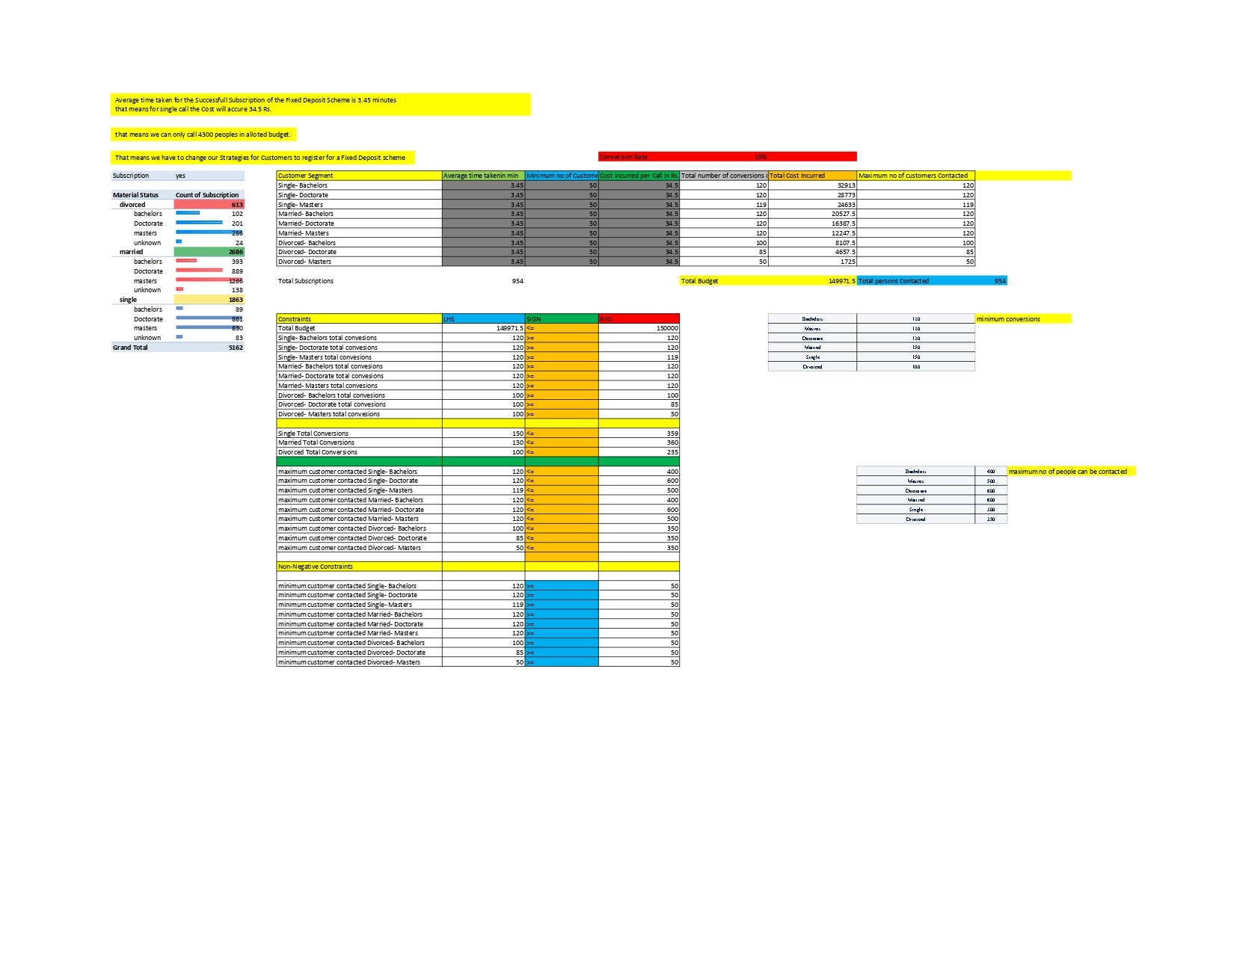
PART III: Optimisation Results Marketing Campaign Optimisation

Slide 16
PART IV: Major insights Marketing Campaign Optimisation
Major insights are drawn from:
Subscribers for the Fixed Deposit Scheme
Loan Amount pending for defaulters
Cash in hand in Bank Account Holders
Education level
Job category
Material Status

